Slide 1
Bladder cancer natural history disease model
Lena Mandrik, Chloe Thomas, Jim Chilcott

Slide 2
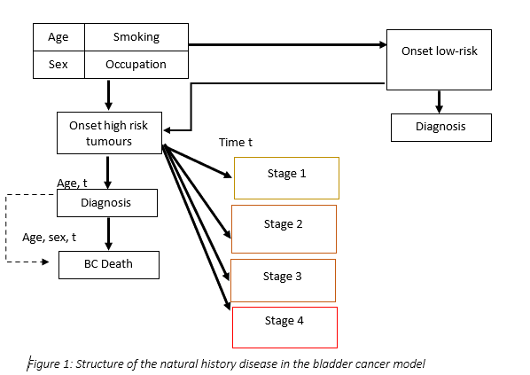
Structure of the NHD part of the model

Slide 3
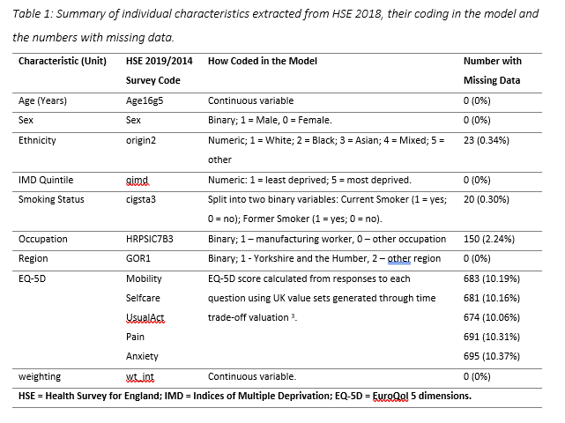
Model population

Slide 4
Model functionality
Natural History
Screening one-time, annual, or biennial
Possibility to input different populations

Slide 5
Modelling assumptions
Smoking cessation is assigned as a constant annual probability to quit smoking;
Smokers have higher other-cause mortality;
Risk factors impact a probability of onset for both LR and HR BC;
No cancer recurrence is modelled for HR BC;
Detected LRBC may progress to HR after the surveillance period (not a NHD part)

Slide 6
Model calibration
Calibration targets
Calibrated parameters
Incidence of HR BC by age, sex, and stage;
Incidence of LR BC.
Mean time to progression was used as an input
Strong priors:
A symptomatic presentation decreases after the age 67 years;
Probability to be diagnosed annually with LR BC is <= 40%;
Probability to be diagnosed in the year of onset for HRBC is <=50%;
The shape in Weibull distribution for stage allocation <=1
RR for males <=10 and the RR for 1 year of age <=2.
Probability of BC onset
Probability to have a low-grade tumour at the time of BC onset
Coefficients of the independent variables in the equation defining the individual probability of BC onset: β_{age}, β_{sex}
Probability to become a symptomatic patient at the year of cancer onset and probability to become a symptomatic patient by time since onset for high-risk BC
Annual probability to become a symptomatic patient for low-risk BC
An annual decrements in symptomatic diagnosis for low-risk and high-risk elderly population group (older than 67 years old)
Shape parameters of tumour progression for the Weibull distributions

Slide 7
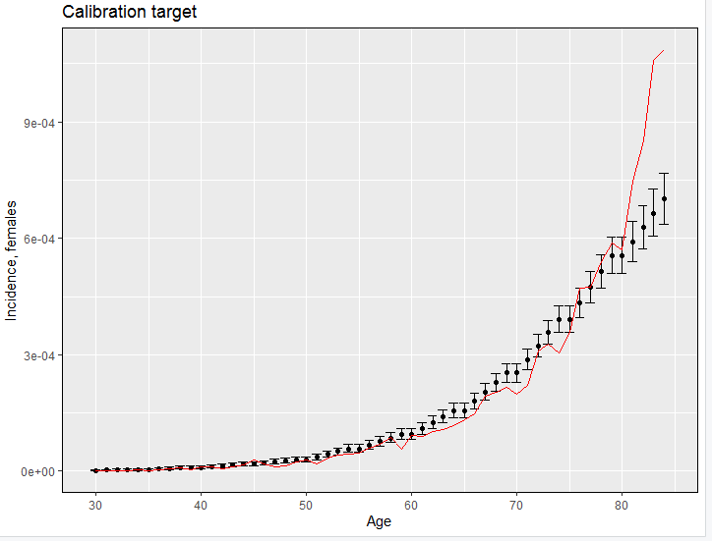
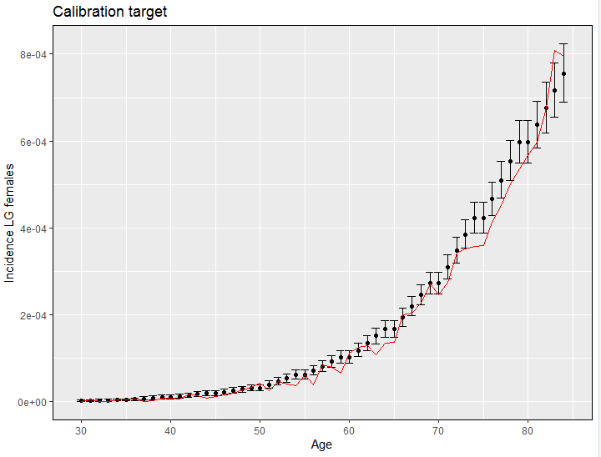
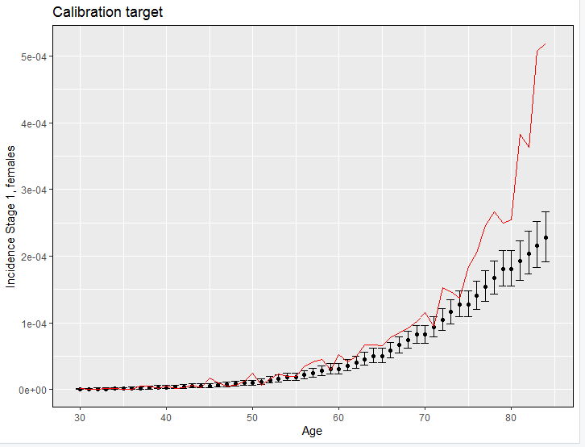
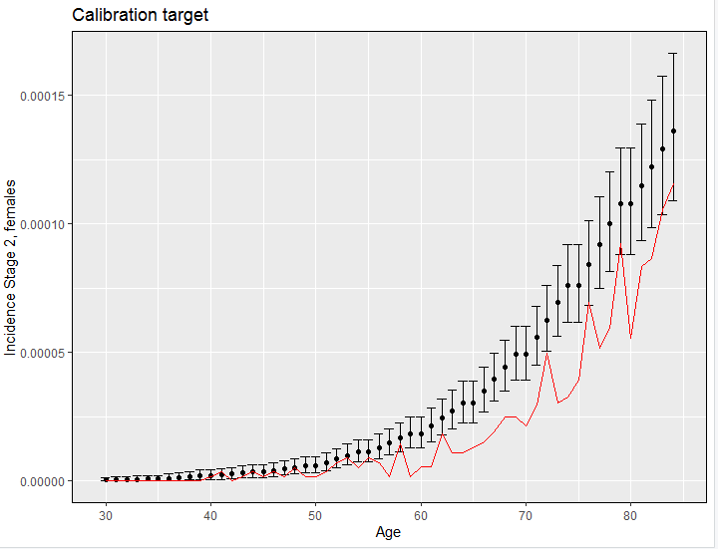
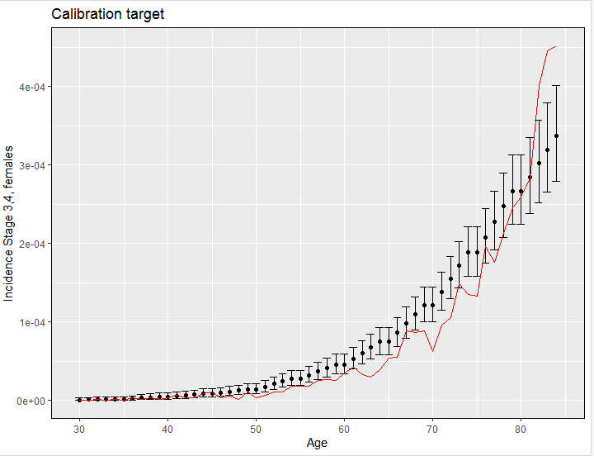
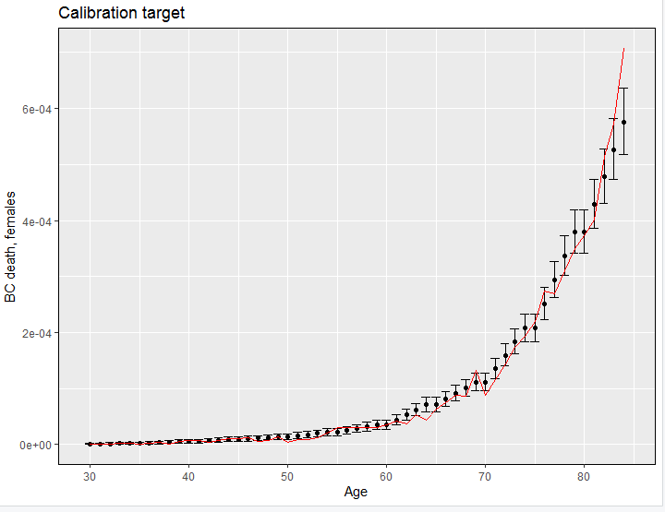
Calibration and validation outcomes

Slide 8
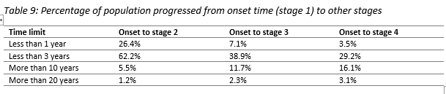
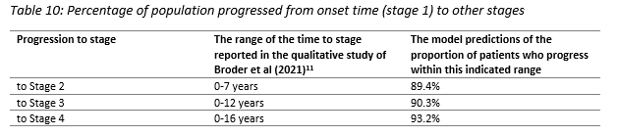
Calibrated model: predictions
80% of patients in the model who had BC onset get diagnosed
Most of the patients progressed to stages 2-4 within 3 years
3% of patients taking more than 20 years to progress to stage 4 from cancer onset

Slide 9
Comparison of No screening vs screen at 70 yo (per 100th simulated people, perfect accuracy)
BC Deaths: 2 less deaths
HR BC: 0.14 more HR cancers diagnosed
LR BC: 16 more LR cancers diagnosed
Proportion of LR that ever progresses to HR – 1.9%

Slide 10
Screening is not cost-effective (per person)
Age | ICER | QALYS | LYS | Cost | Cancer Deaths
75 | 182,512.28 | 5.85305E-06 | 1.12353E-05 | 1.068253 | -1.25975E-05
72 | 199,510.44 | 7.40818E-06 | 1.20703E-05 | 1.47801 | -8.43538E-06
70 | 191,104.63 | 9.34941E-06 | 1.95063E-05 | 1.786716 | -1.392E-05
68 | 170,892.05 | 1.30307E-05 | 1.72255E-05 | 2.226836 | -1.11462E-05
66 | 160,720.36 | 1.63033E-05 | 2.64543E-05 | 2.620276 | -1.29053E-05
64 | 194,747.58 | 1.63241E-05 | 2.75317E-05 | 3.179075 | -9.49699E-06
62 | 184,031.24 | 1.98466E-05 | 3.42562E-05 | 3.652403 | -9.60922E-06
60 | 446,476.72 | 9.41599E-06 | 1.07775E-05 | 4.204021 | -4.63888E-06
58 | 396,739.61 | 1.09234E-05 | 1.09234E-05 | 4.33376 | -3.69484E-06

Slide 11
Quick progression and symptoms, are key determinants
On population without competing mortality, the probability to get diagnosed in one year increase from 15% for stage 1 to 19% for stage 4
Sensitivity with 50% less symptomatic presentation did not affect ICER much
High other-cause mortality for smokers (1.2 for former and 2.76 for current) means that even with higher RR of bladder cancer for smokers screening is not cost-effective
Comparator | Stage 1 (HR) | Stage 2 | Stages 3,4
Symptomatic cancers | 14.3% | 22% | 63%
Screen-detected cancers | 14.5% | 33% | 52%

Slide 12
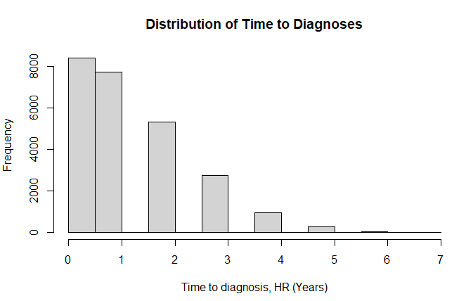
No screening: time from HR onset to diagnosis
Mean time to diagnosis for HR
(diagnosed cancers): 1.25; sd (1.2)

Slide 13
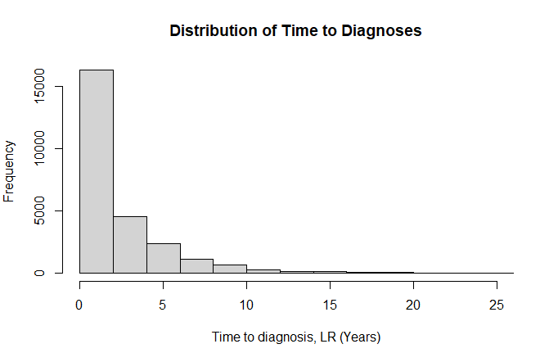
No screening: time from LR onset to diagnosis
Mean time to diagnosis for LR
(diagnosed cancers): 2.45; sd (2.9)

Slide 14
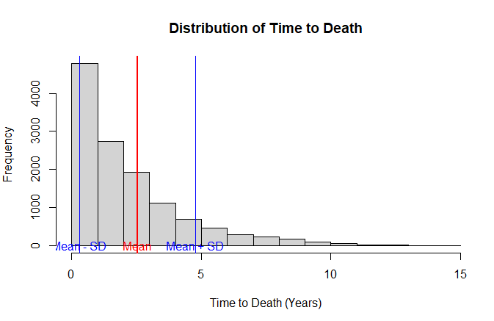
No screening: time from HR onset to death
Mean time to death (diagnosed cancers): 2.45; sd (2.24)

Slide 15
Changes for the next re-calibration
Additional parameter - undiagnosed mortality to BC stage 4 (i.e. mortality at the time of death) -is added to the model. This parameter needs to be calibrated
Probability to be diagnosed changed from linear function based on time from onset to an annual probability to get diagnosed in each stage (+2 more parameters).
The assumptions on disease progression changed. Originally the mean was equalised to the median reported in Broder (2021) study. In the new version the median was converted by simulating the 1 mln values assuming the beta distribution and that the reported range actually is a 90% CI. The remaining outliers were considered to be distributed within the 5 following years. The new calculated means were: Stage I to Stage II: 4 years (4.2724); Stage II to Stage III: 3 years (3.1811); Stage III to Stage IV: 2 years (1.9537). The second scenario will rely on the similar assumptions as in the Grail model on the exponential progression of cancer with the Stage I to II progression be replaced with the double time from stage II to Stage III: 6.3622.
The shape should be the same on smaller for more advanced cancer, assuming that there is more homogeneity for late-stage than early stage cancers

